Slide 1
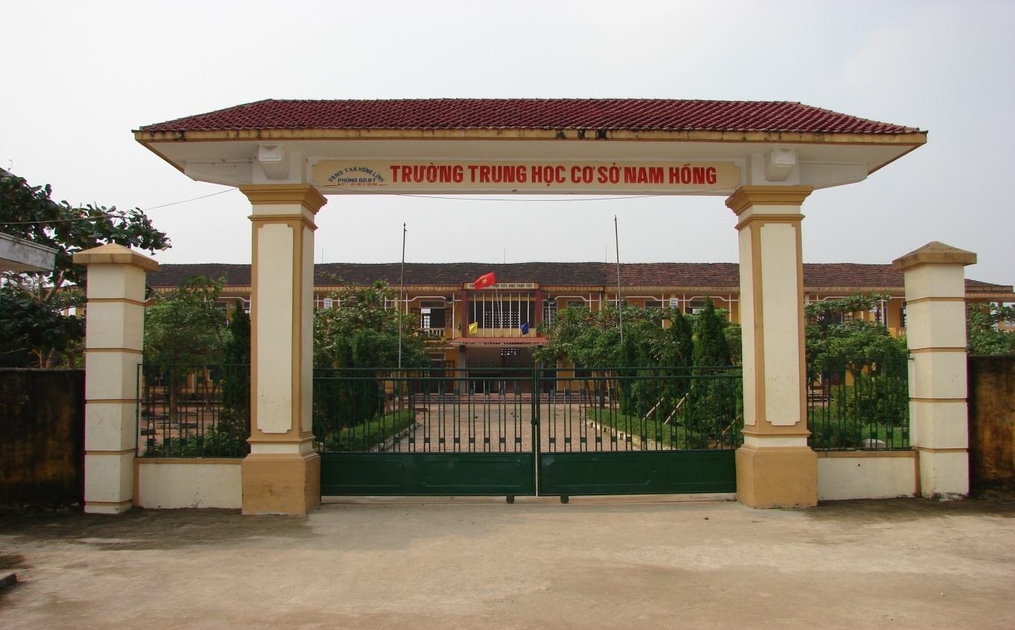

Thanh Am Primary school
Welcome to English class 3
Welcome to English class 3

Slide 2

Unit 6: Stand up!
Lesson 1 (P. 40)

Slide 3
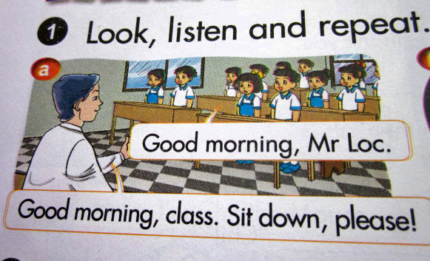
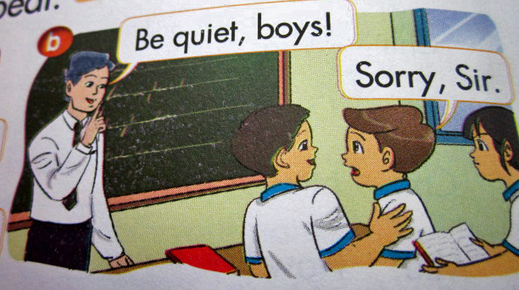
1. Look, listen and repeat

Slide 6
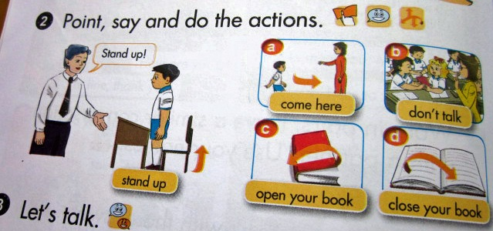

Slide 7
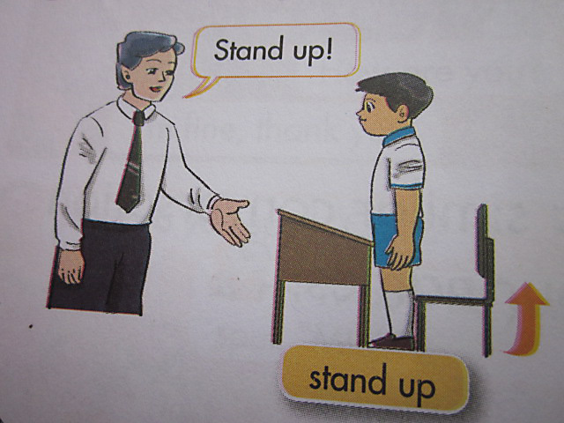
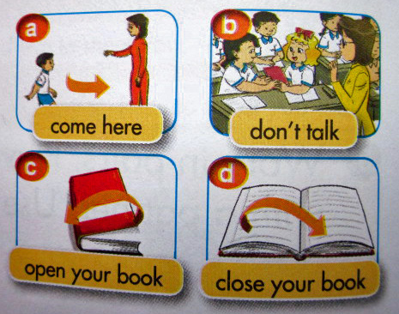
2. Point, say and do the actions

Slide 8
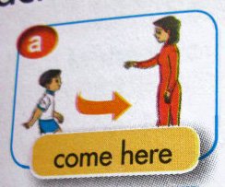

Slide 9


Slide 10


Slide 11


Slide 12
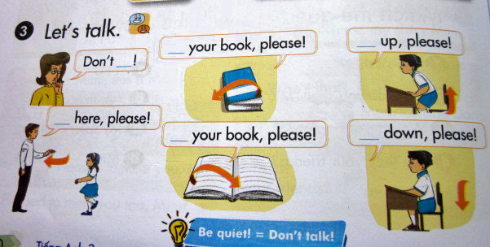

Slide 13
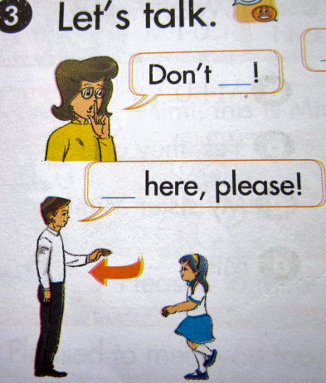

Slide 14


Slide 15
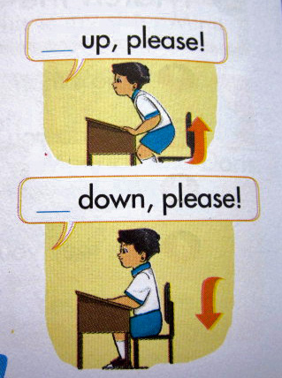

Slide 16
1. Put the letters in order to make the words
d. Stand up
a. open
d. Tdnas
……… up
a. pnoe
b. close
b. eclso
e. Its
……. down
e. Sit down
c. Cemo
……. in
c. come in
f. don’t talk
f. Ltak
Don’t …..

Slide 17
2. Read and match
1. Sit
a. up, please.
2. Stand
b. your book.
3. Come
c. down, please.
4. Open
d. here, please

Slide 18
Thank you very much
Goodbye
See you later

